Slide 1
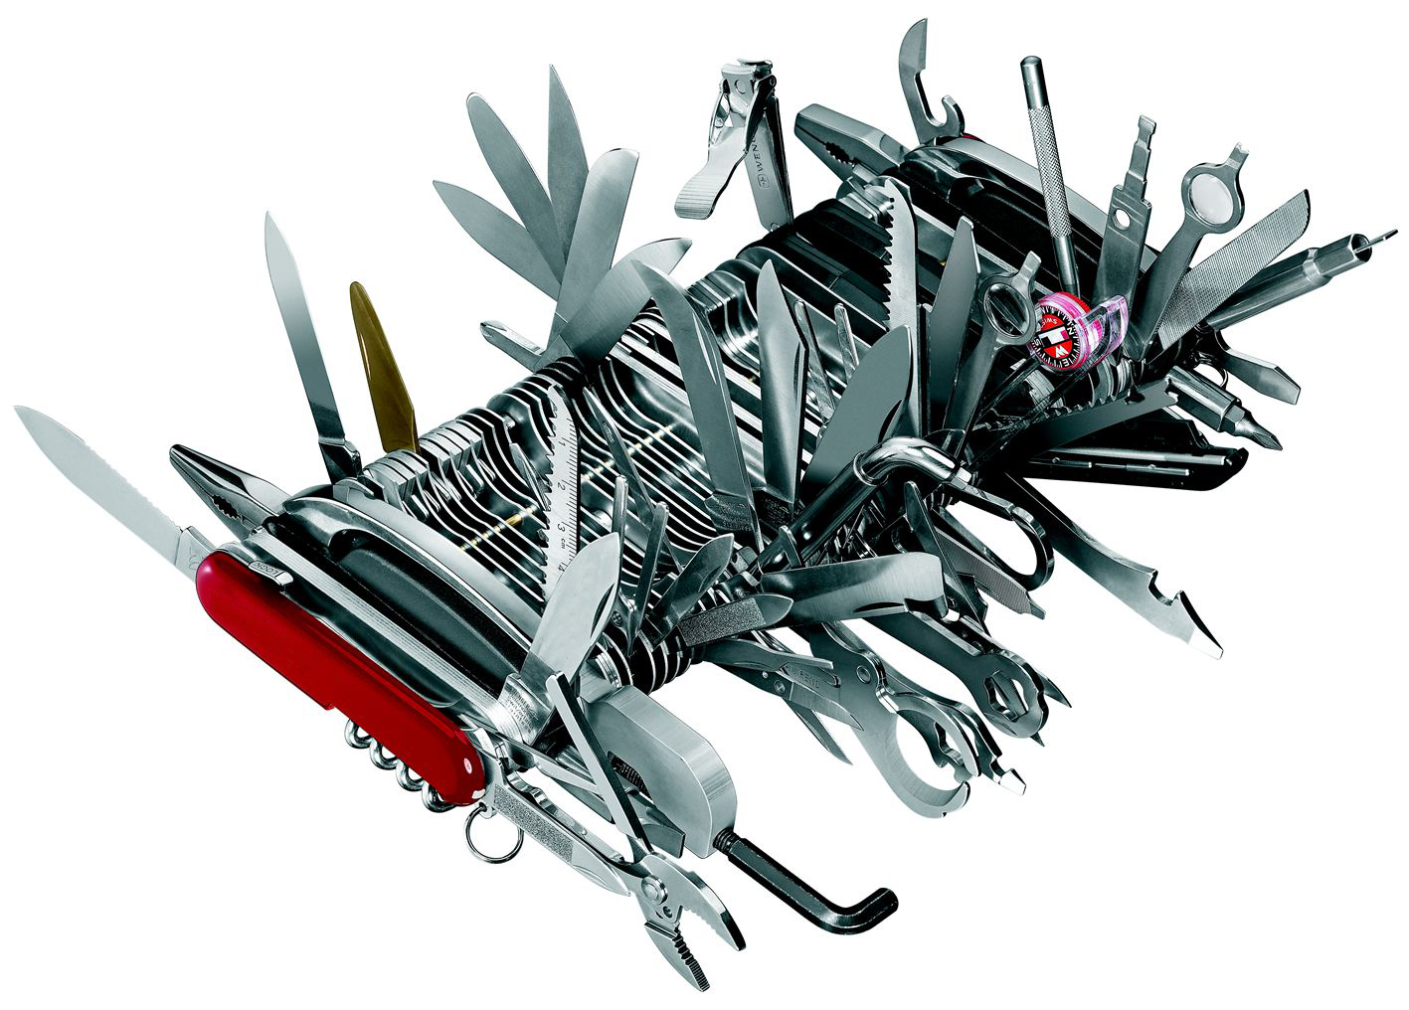
Local Marketing For Nonprofits
There’s No Perfect Tool

Slide 2
Marketing & Donor Development is about getting your message, to the right people, at the right time using the right medium …
Sounds easy… Right?

Slide 3

How do you stand out from the crowd?
The average person is exposed to more than 1.85 million messages per year
  5,000 per day
  Notice only about 50
  Remember only 4

Slide 4
Tools to Successful
Multi-Channel Local Marketing
& Donor Development
Direct Mail
Website & Mobile Marketing Online & Local Search
Social Media
Direct Mail
Web Tools
Social Media

Slide 5
Direct Mail is Alive!
Attitudes Toward Direct Mail & Email
Percent of population agreeing to the following statements:
  Get a lot more emails that I do not open 75%
  Enjoy getting postal mail about new products 59%
  Enjoy getting email about new products 43%
  Postal mail gets more attention 50%
  Receive too many emails in one day 65%
  Enjoy checking postal mailbox 60%
Direct Mail
Web Tools
Social Media

Slide 6
Make Your Mailing Stand Out
Know Your Audience
Sometimes it’s the simple things
Think Outside of the Box
Direct Mail
Web Tools
Social Media

Slide 7
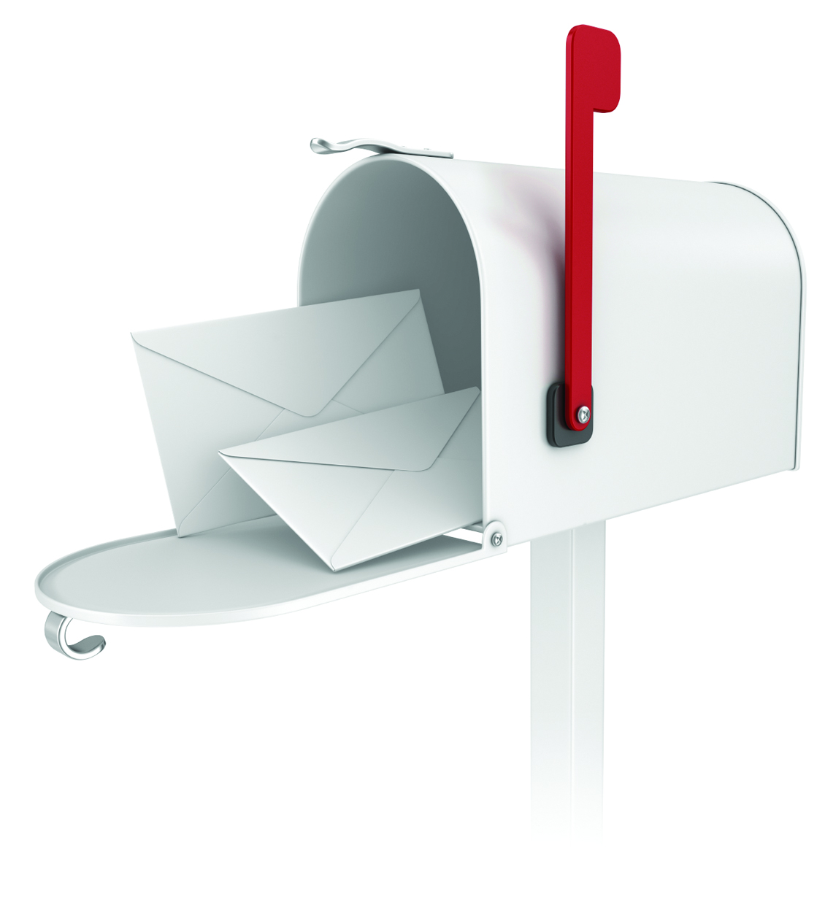
EVERY DOOR DIRECT MAIL®
BENEFITS OF EVERY DOOR DIRECT MAIL (EDDM)
  Reach
    Up to 85% of a small business’ customers come from a 5 mile radius.*
    A business can reach every address in the area surrounding their business with EDDM.
  Cost Effective
    Postage is a low as 17.5 cents a piece!
    No need to purchase a list of names
  Ease
    No postage permit required
    No addressing required
*Source: BizReport 2010
Direct Mail
Web Tools
Social Media

Slide 8
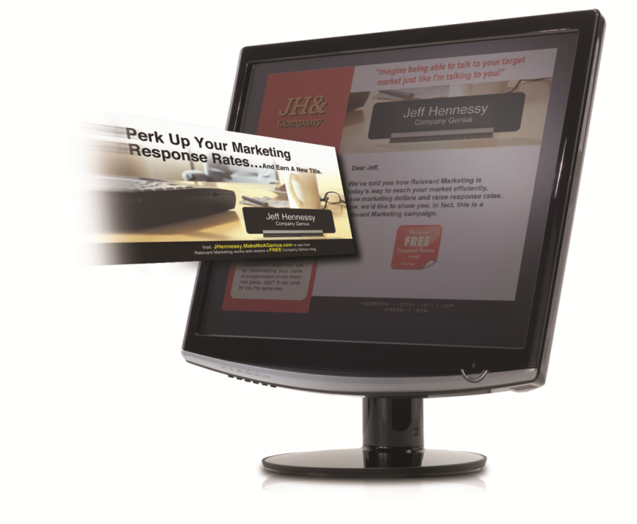
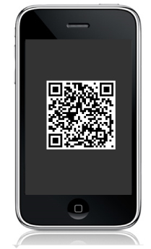
Personalizing Your Campaigns
43% of people prefer to respond to direct marketing online.
Every direct marketing campaign should include an effective online response option.
Quick Response Codes
Use QR Codes for a quick link to your mobile site.
Make it easy to give
Direct Mail
Web Tools
Social Media

Slide 9
Web Tools
Be Seen Where They’re Looking
Direct Mail
Web Tools
Social Media

Slide 10
If you build it, they will come.
Direct Mail
Web Tools
Social Media

Slide 11
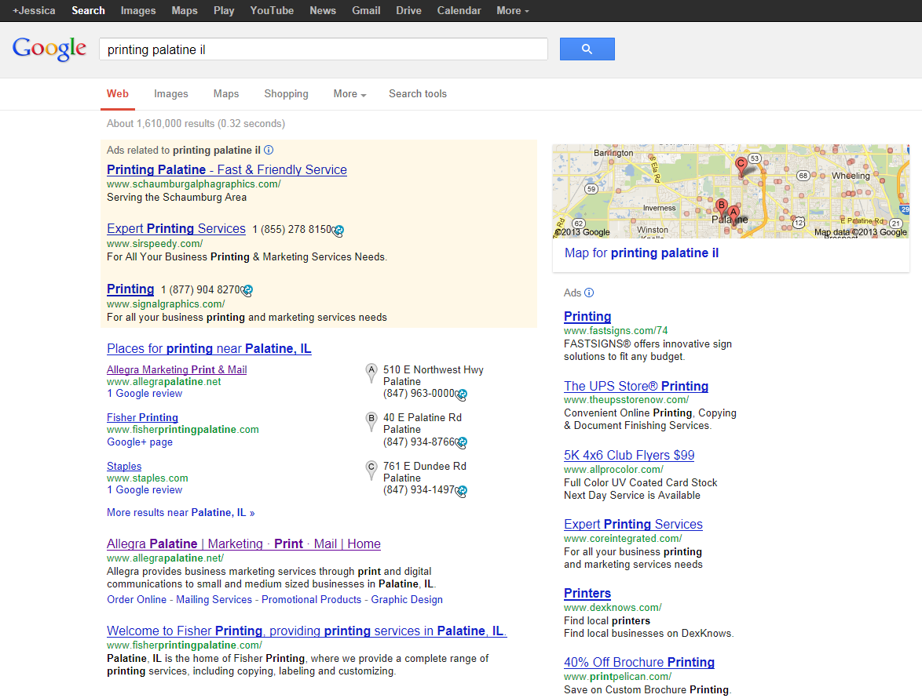
Location, Location, Location!
PAID
LOCAL
PAID
STANDARD
Direct Mail
Web Tools
Social Media

Slide 12
Location, Location, Location!
PAID
Pay-Per-Click: Google, Bing & Yahoo all have PPC Advertising.
Local Listings: Google+, YP, Yelp, Foursquare, Yahoo Local, Super Pages…
Search Engine Optimization: S.E.O., the greatest mystery on the web. Keywords, Meta Tags, Links, Content, Updates…
LOCAL
STANDARD
Direct Mail
Web Tools
Social Media

Slide 13
Allegra Cares &
Google Grants
Receive up to $10,000 per month in free online advertising
Promote your events
Find Volunteers
Increase Donations
Direct Mail
Web Tools
Social Media

Slide 14
Mobile Usage Facts
As of 2013 More People will use mobile phones than PCs to get online.
Mobile searches have increased 4x since 2010
There will be one mobile device for every person on earth by 2015.
60% of users expect a mobile site to load in three seconds or less.
71% of users expect a mobile site to load as fast as a desktop site.
78% of users will retry a site two times or less if it does not load initially.
23% of adults have cursed at their phone when a site doesn’t work
Direct Mail
Web Tools
Social Media
Source: Google Research Study 2013

Slide 15

Optimize for Mobile
10%
Only 16% of all nonprofit websites are optimized for mobile
Direct Mail
Web Tools
Social Media
Source: National Center for Charitable Giving

Slide 16
Go to www.derby-sheltonrotary.org
See the difference!
Go to
www.allegrashelton.com
Direct Mail
Web Tools
Social Media

Slide 17
Why Do You Need To Be Seen
Where They’re Looking?
13.5% Increase in Online Fundraising in 2013
75% of Donor spend less than 2 hours researching a nonprofit before giving
32% increase in mobile subscriber lists for nonprofits in 2012
62% of Generation Y Donors would give by Mobile Phone
84% of nonprofit donation landing pages ARE NOT optimized for mobile
65% of nonprofits make donors click 3 or more times to give a donation
Direct Mail
Web Tools
Social Media
Source: National Center for Charitable Giving

Slide 18

Social Media Marketing
1. Have a page
  Facebook
  Twitter
  LinkedIn
  Google+
  YouTube
2. Create content that is “share-worthy”
Direct Mail
Web Tools
Social Media

Slide 19
Social Media Marketing
Consider your audience
Engage your audience: Provide the user a reason to share – and make it easy
Be personable
Be timely, i.e. don’t write about old news
Ask yourself, “who cares?”
Fulfill a purpose (informative, how-to, etc.)
Prompt interest or action
Direct Mail
Web Tools
Social Media

Slide 20
porter@allegrashelton.com
If you would like more information about local marketing or any of these topics please contact me at…
Direct Mail
Web Tools
Social Media

